Slide 1
Lecture 02 - Image Filtering
Prof. André Gustavo Hochuli
gustavo.hochuli@pucpr.br
aghochuli@ppgia.pucpr.br
Notes:
Prof. André Hochuli

Slide 2
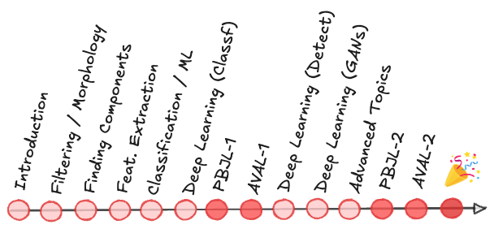
Topics
Discussion of Practice 01
Image Filtering
Convolution
Mean, Median, Gaussian Filters
Practice
Computer Vision - Prof. André Hochuli
Lecture 02
Notes:
Prof. André Hochuli

Slide 3
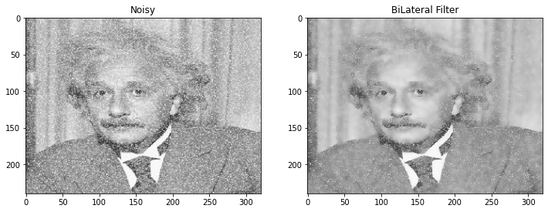
Image Filtering
_{Image Enhacement}
_{Noise Reduction}
_{Mathematical Operations}
Computer Vision - Prof. André Hochuli
Lecture 02
Notes:
Prof. André Hochuli

Slide 4
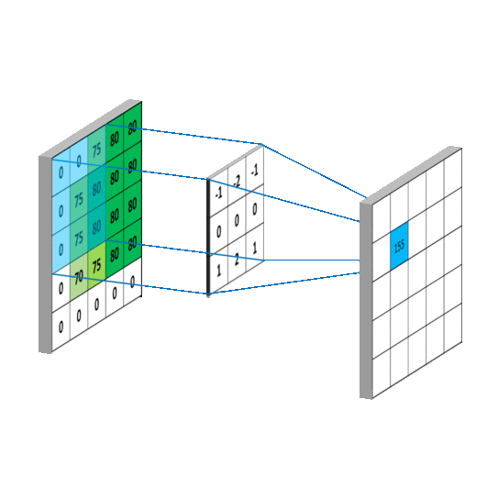
Convolution
Slides a kernel (a.k.a convolution filter) in the entire image
Transforming the pixel in the center of the kernel by the weights of its neighbors.
Computer Vision - Prof. André Hochuli
Lecture 02
Notes:
Prof. André Hochuli

Slide 5
Convolution
Computer Vision - Prof. André Hochuli
Lecture 02
Notes:
Prof. André Hochuli

Slide 6
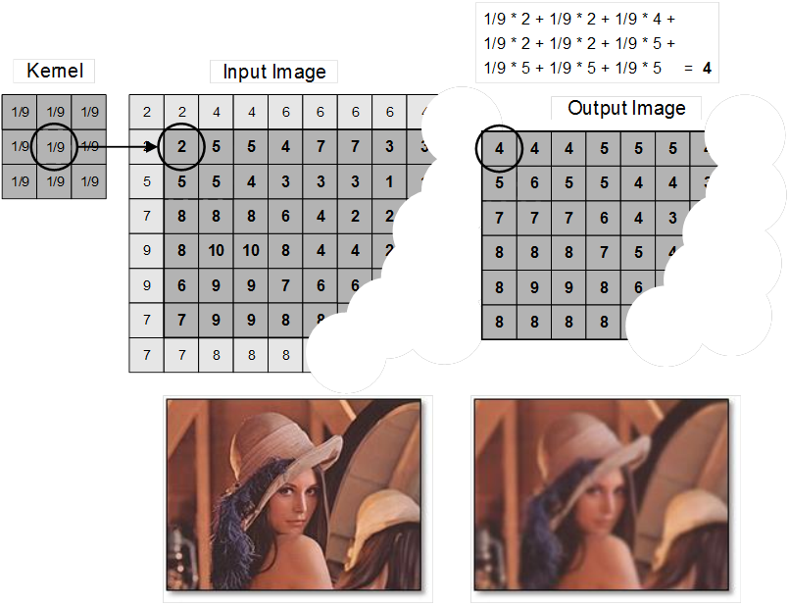
Mean Filter
Replaces the center pixel with the mean of its neighborhood
Spreads the outlier value to its neighbors
_{Details are smoothed}
Computer Vision - Prof. André Hochuli
Lecture 02
Notes:
Prof. André Hochuli

Slide 7
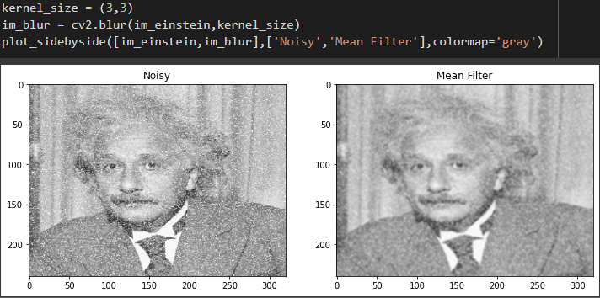
Mean Filter
Replaces the center pixel with the mean of its neighborhood
Spreads the outlier value to its neighbors
_{Details are smoothed}
Computer Vision - Prof. André Hochuli
Lecture 02
Notes:
Prof. André Hochuli

Slide 8
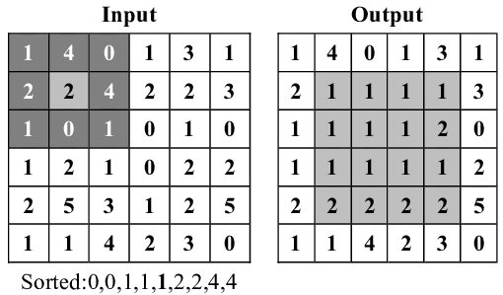
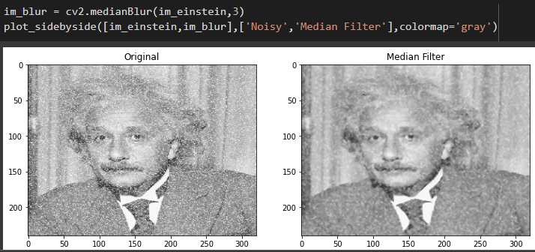
Median Filter
Replaces the center pixel with by a median of its neighborhood
Preserves more details when compared to the mean filter
Computer Vision - Prof. André Hochuli
Lecture 02
Notes:
Prof. André Hochuli

Slide 9
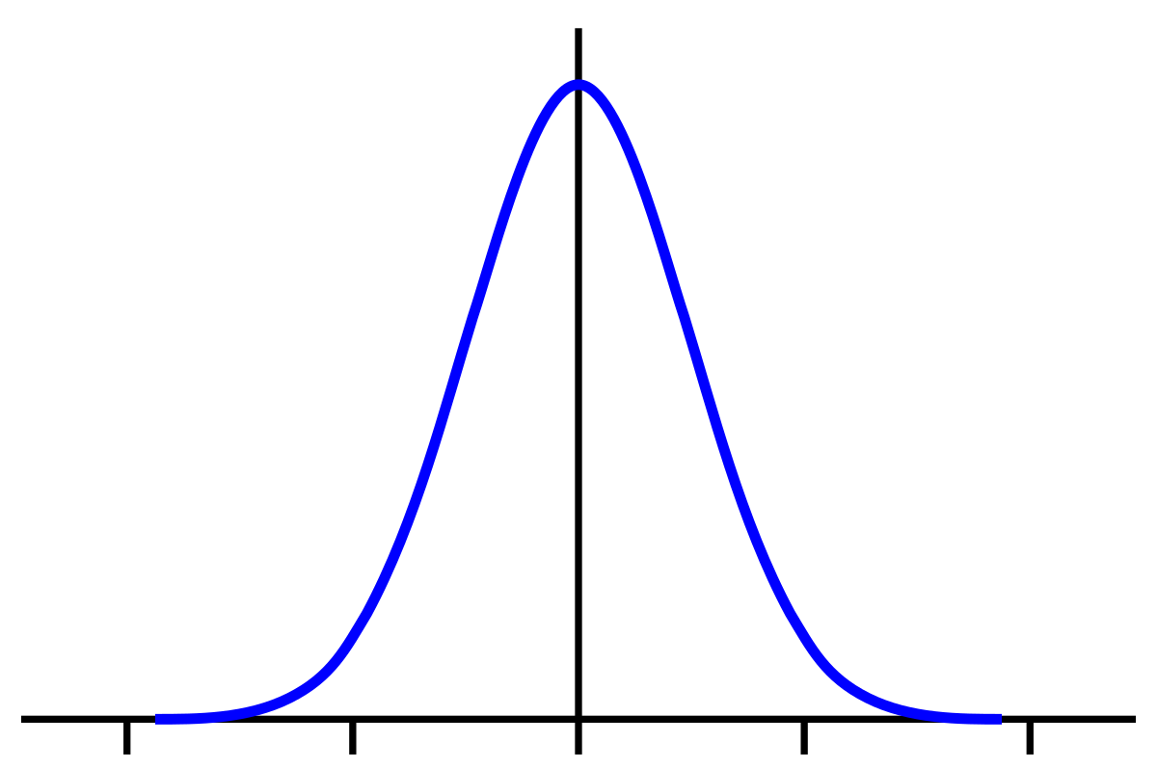
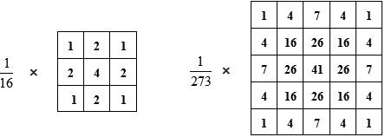
Gaussian Filter
Gaussian distribution of pixels
The kernel is composed of probabilities
_{Weighted Mean}
The standard deviation determines the blur degree
Computer Vision - Prof. André Hochuli
Lecture 02
Notes:
Prof. André Hochuli

Slide 10
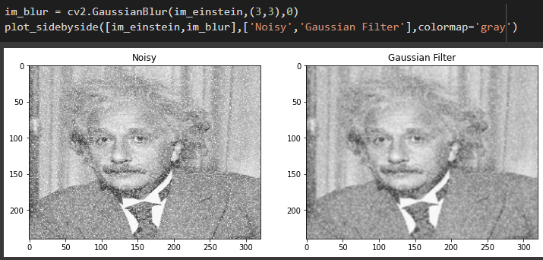
Gaussian Filter
Gaussian distribution of pixels
The kernel is composed of probabilities
_{Weighted Mean}
The standard deviation determines the blur degree
Computer Vision - Prof. André Hochuli
Lecture 02
Notes:
Prof. André Hochuli

Slide 11
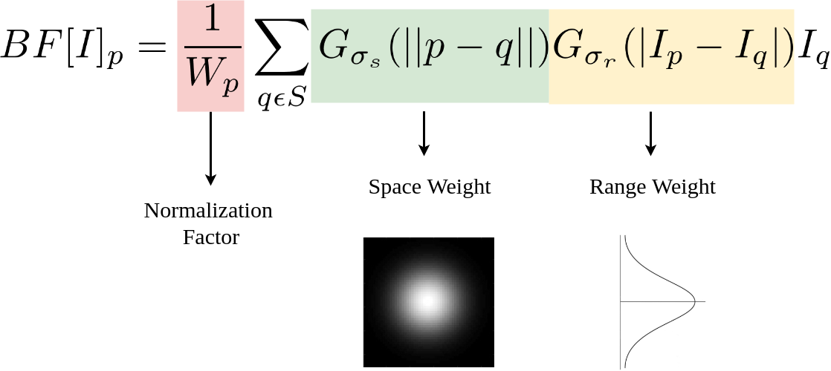
Bilateral Filter
Gaussian Distribution based (spacial and pixel intensity)
Add Normalization Factors and Range Weight
_{Preserve details}
Computer Vision - Prof. André Hochuli
Lecture 02
Notes:
Prof. André Hochuli

Slide 12
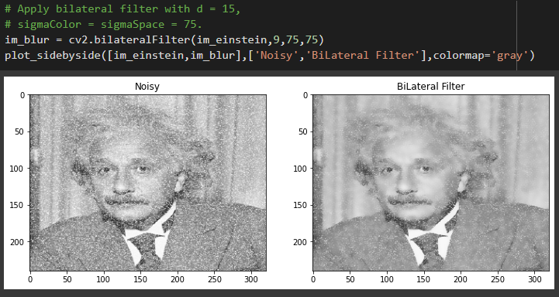
Bilateral Filter
Gaussian Distribution based (spacial and pixel intensity)
Add Normalization Factors and Range Weight
_{Preserve details}
Computer Vision - Prof. André Hochuli
Lecture 02
Notes:
Prof. André Hochuli

Slide 13
Practice
_{Link: Practice 02}
Computer Vision - Prof. André Hochuli
Lecture 02
Notes:
Prof. André Hochuli

